Slide 1
ERICH & MICHAEL’S WEDDING
MAY 23RD, 2026
100 GUESTS
CHÂTEAU DE SAINT-MARTIN DU TERTRE
WEDDING MOOD BOARD

Slide 2
COLOR PALETTE
MAY 23RD, 2026:
CEREMONY: WHITE/GREENERY
COCKTAIL & RECEPTION/DINNER: WHITE/GREENERY
WELCOME PARTY: WHITE/GREENERY
BRUNCH: WHITE

Slide 3
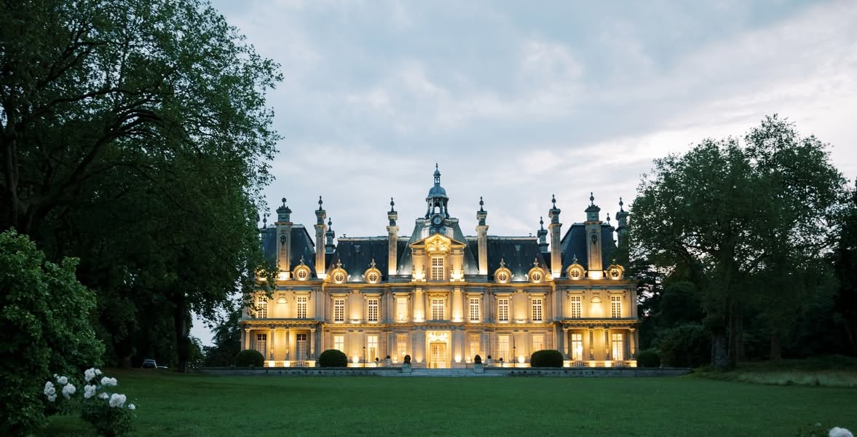
CEREMONY DECOR
The ceremony will take place at Château de Saint-Martin du Tertre

Slide 4
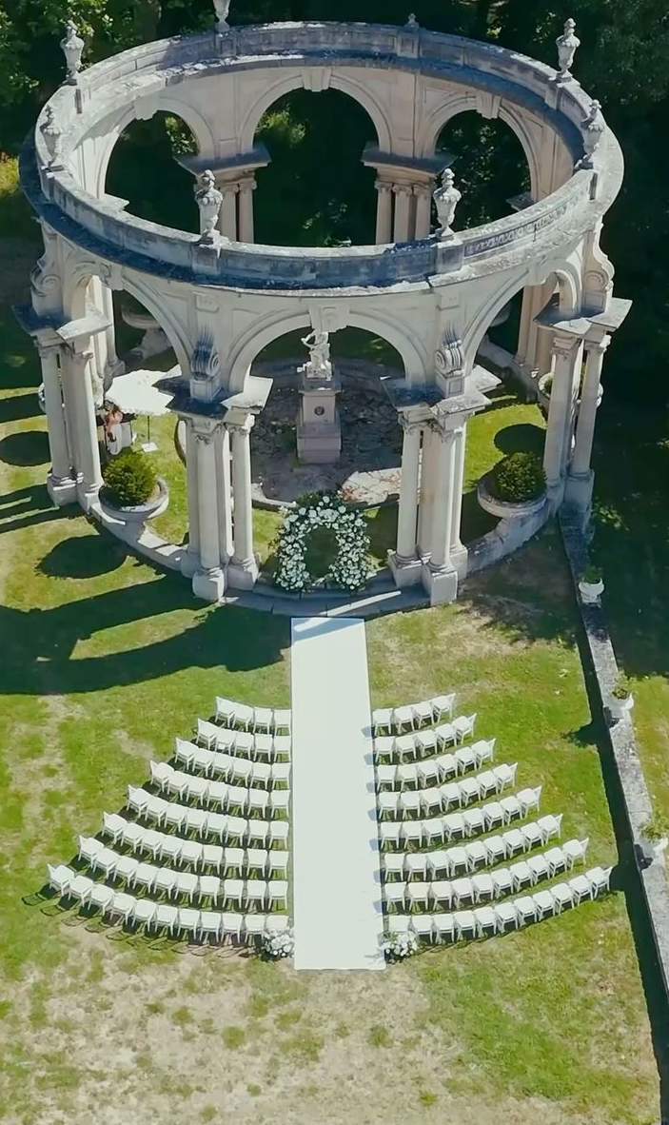
ALTAR DECOR
A white runner will be laid along the aisle, leading to the altar
White floral arrangements will be positioned at the front of the altar on each side, elegantly framing the ceremony space
Guest chairs will be elegantly arranged in alignment with the reference image, creating a harmonious and refined seating layout

Slide 5
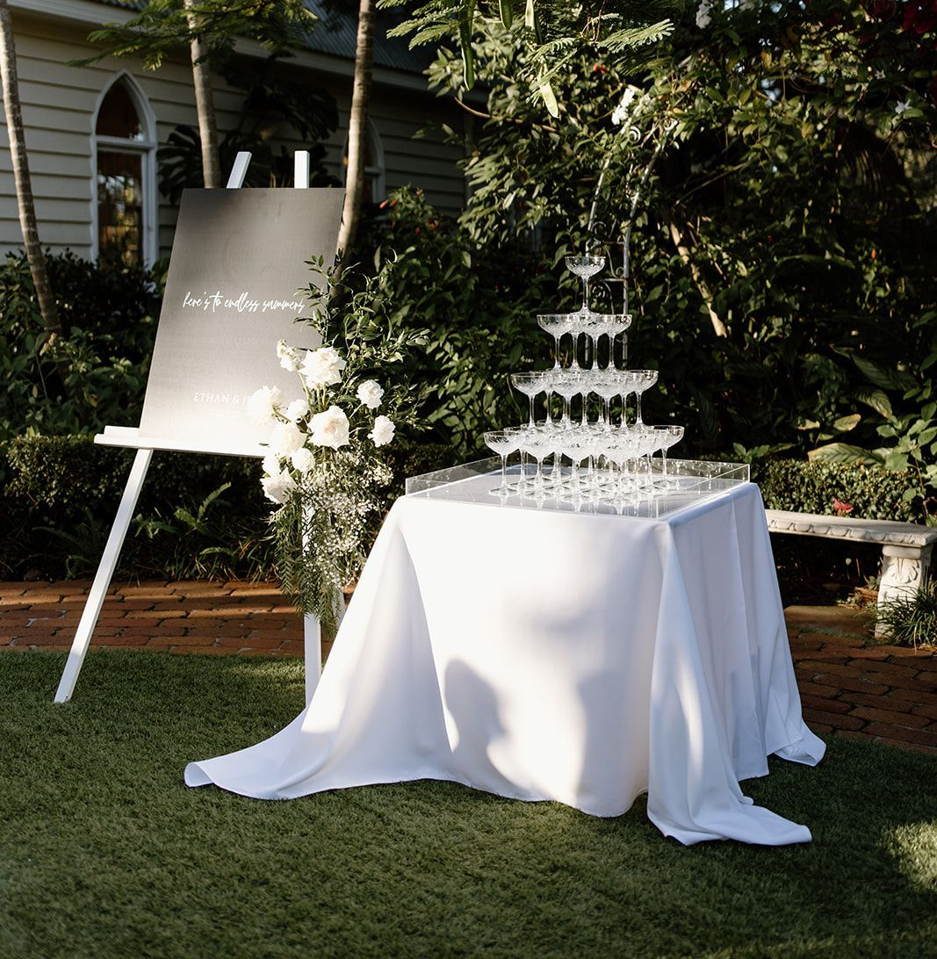
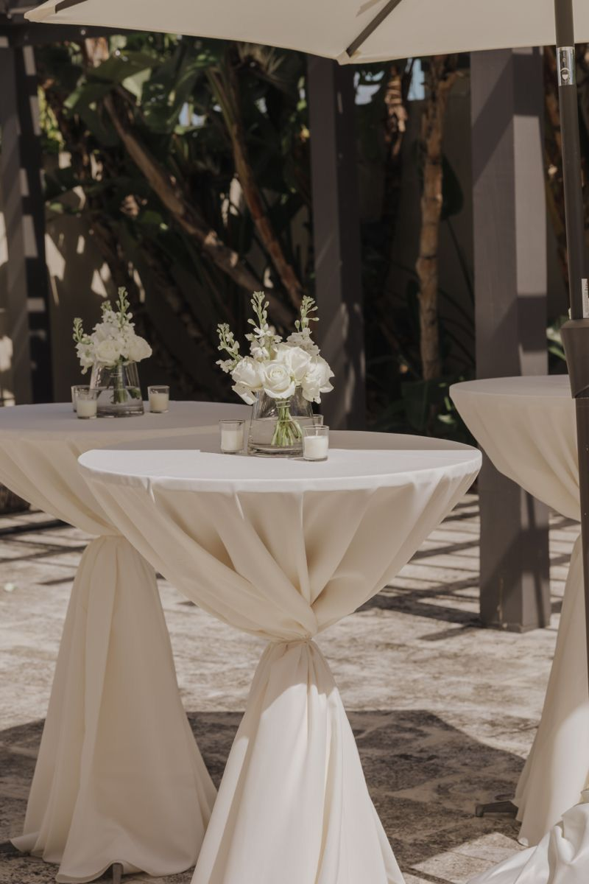
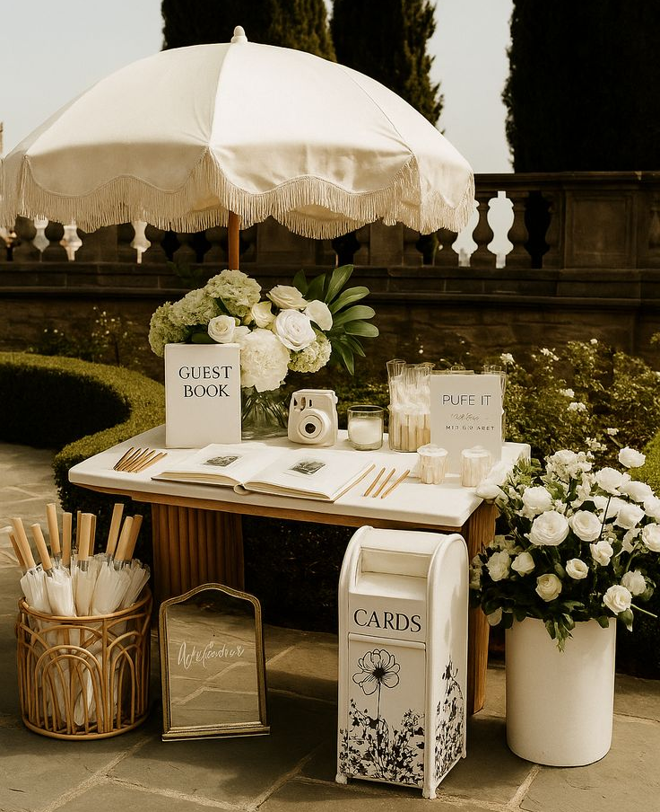
COCKTAIL
A carefully curated arrangement of lounge tables, accented with elegant white drapery, will offer guests an inviting space to unwind
Each table will feature delicate white floral arrangements, presented in small crystal vases
A champagne pyramid will be set up and available for guests to enjoy
Guestbooks will be displayed and available for all guests, as shown in the reference image

Slide 6
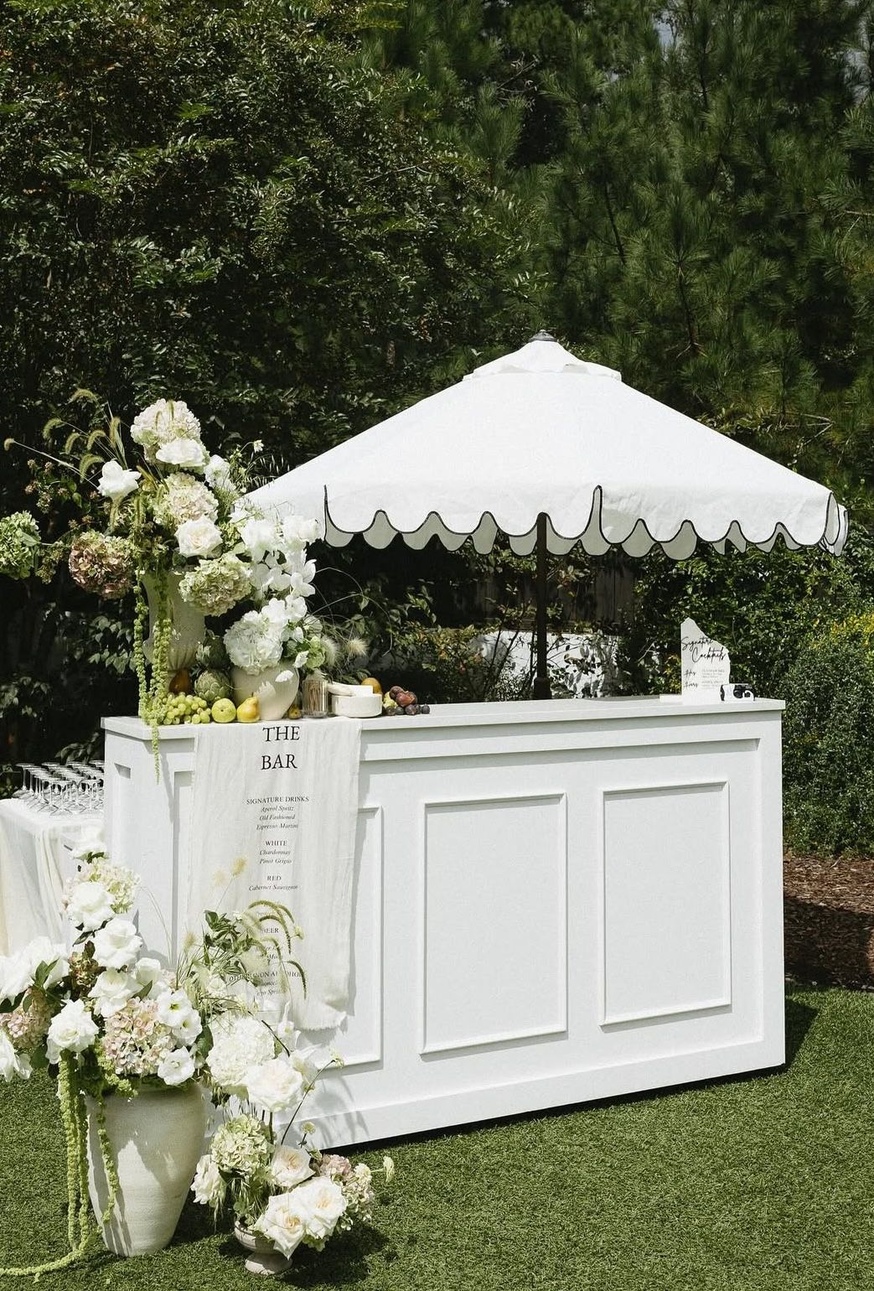
BARS RENTAL & DECOR
A refined white bar, inspired by the provided reference image, will anchor the cocktail space, complemented by one floral arrangement placed at the base and another displayed atop the bar in antique white vases
A bespoke banner will be designed and printed, showcasing the selected beverages
The décor will echo the reference imagery, styled in harmony with the color palette detailed on slide #2

Slide 7
SIGNS
Audrey’s note: To create an harmony between the differents signage I recommend using the same font style and color (as much as possible) – TBC with Erich or Michael a design proof will be sent.

Slide 8
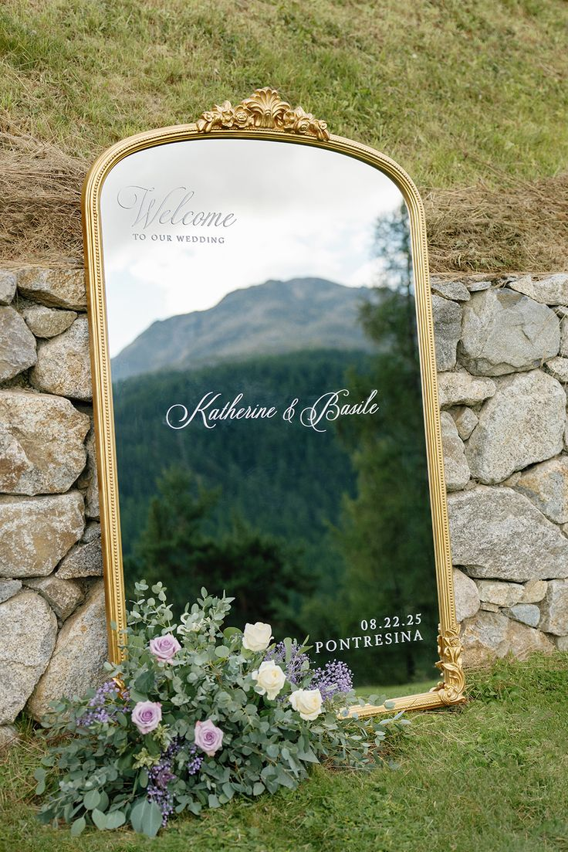
Welcome Sign & Décor
A Baroque-style gold mirror will elegantly showcase the groom and groom’s names in white script, alongside the wedding date, radiating timeless sophistication and refined elegance

Slide 9
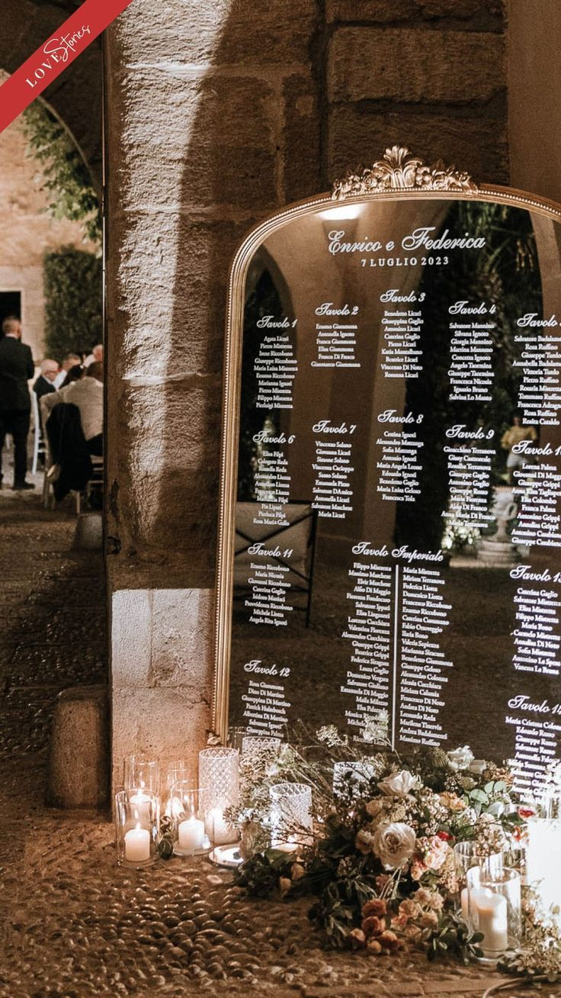
Seating Chart
A large rectangular mirror with a gold frame will display the seating chart, featuring white script typography elegantly presenting each table number and guest names
A medium-sized floral arrangement will be displayed at the base of the seating chart, accompanied by candles of varying heights, with décor reflecting the reference imagery and styled in harmony with the color palette detailed on slide #2

Slide 10
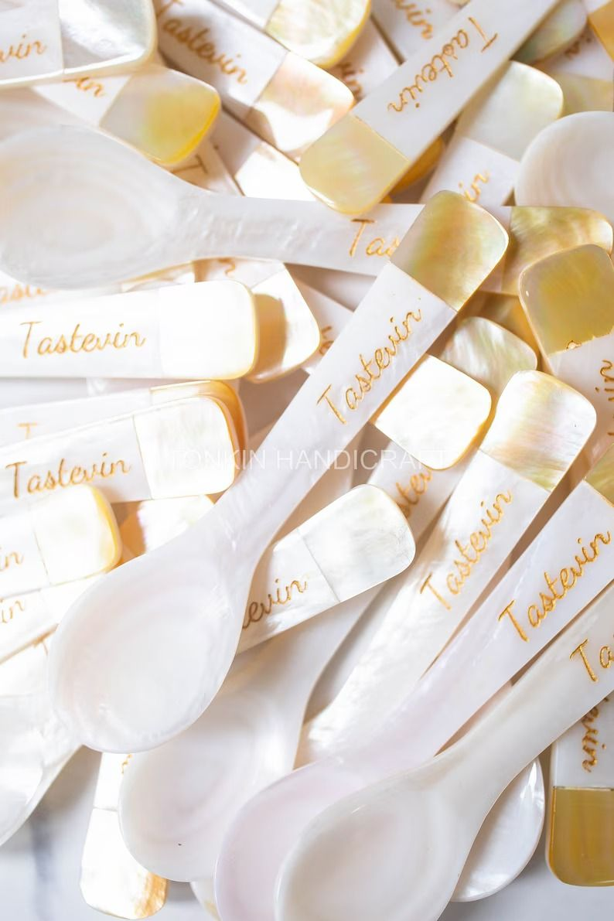
Place Cards
Audrey’s Note:
Please note that place cards are required by the catering staff regardless of round or rectangular tables. For weddings with more than 100 guests, place cards must be placed on each table with assigned seating, showing each guest’s full name, table number, and a meal icon/allergy note to guide the staff.

Slide 11
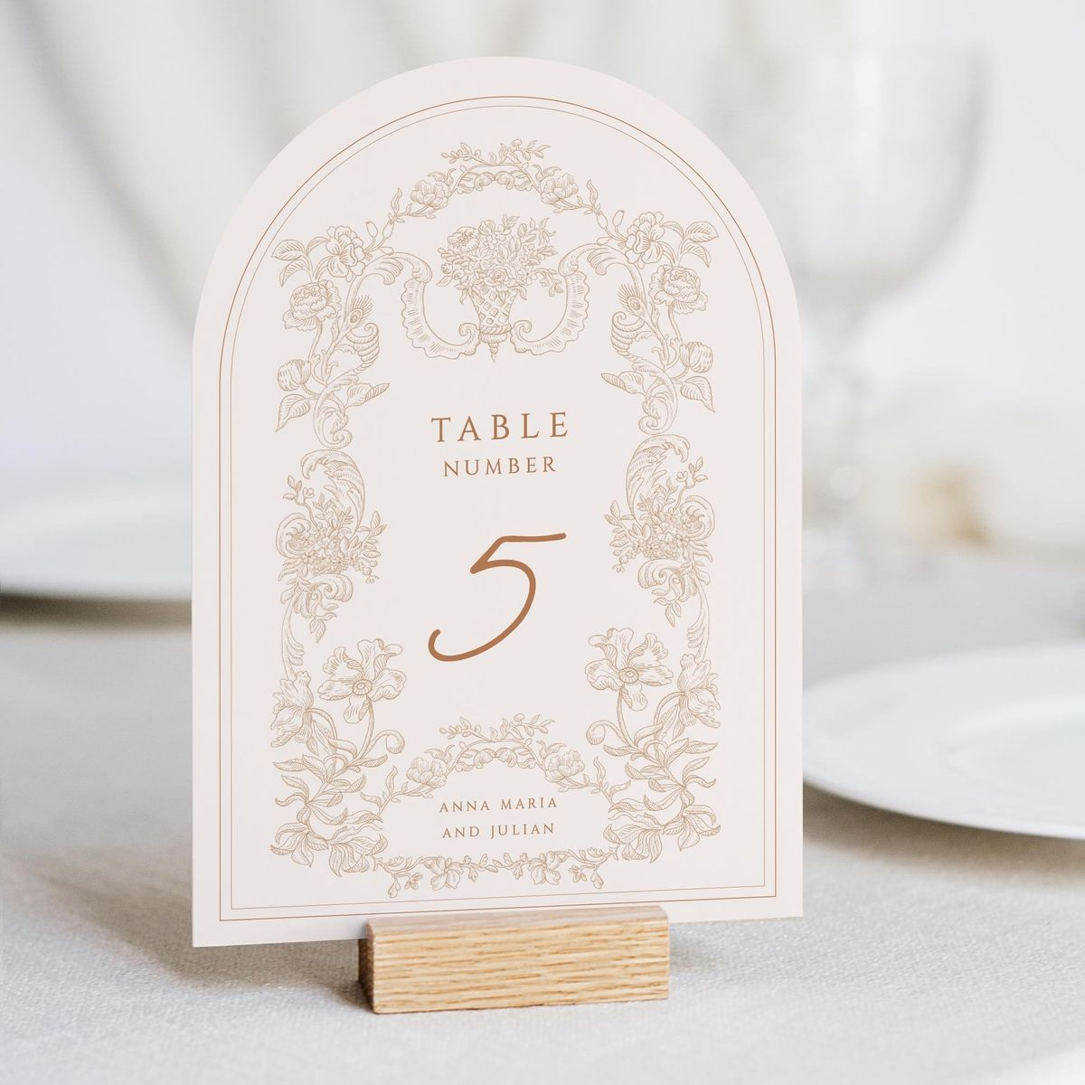
Table numbers
A refined rectangular design with a rounded top, printed on warm white paper and adorned with delicate light brown floral motifs and dark brown script typography, will be elegantly presented on a wooden holder.

Slide 12
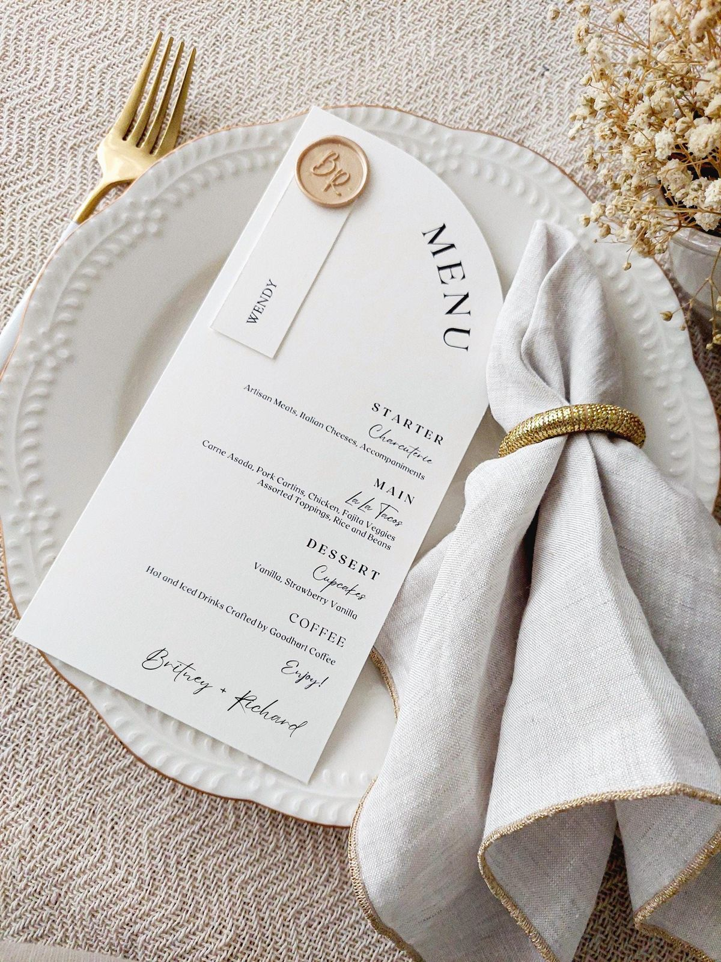
Menus
A large rectangular design with a rounded top, crafted from smooth, thick white matte paper, adorned with elegant dark script typography and finished with a gold wax stamp, creating a refined and harmonious statement

Slide 13
RECEPTION DÉCOR

Slide 14
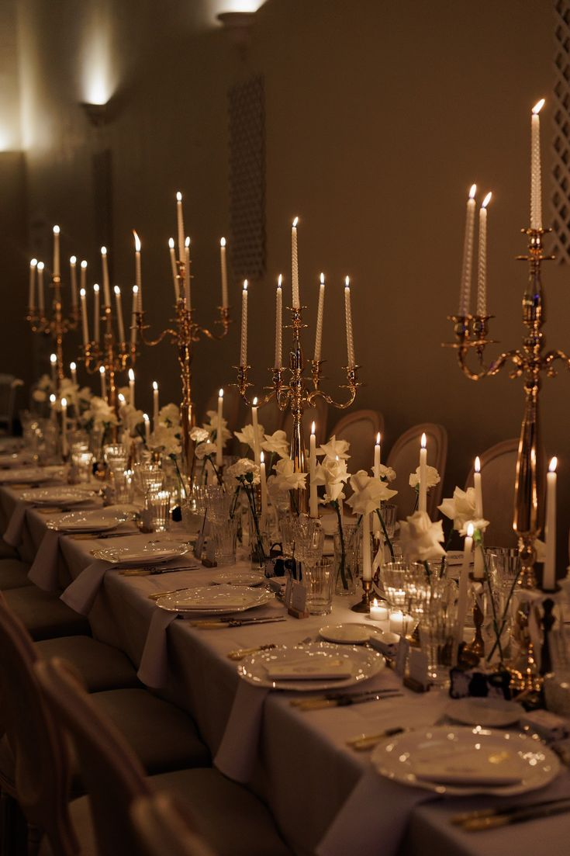
Rectangular Tables
For the rectangular table décor, the aesthetic remains light, airy, and romantic. Each table will feature multiple medium-low floral arrangements, elegantly arranged from end to end in small crystal vases and surrounded by tall gold taper candles, creating a warm, timeless, and effortlessly sophisticated ambiance

Slide 15
RENTALS

Slide 16
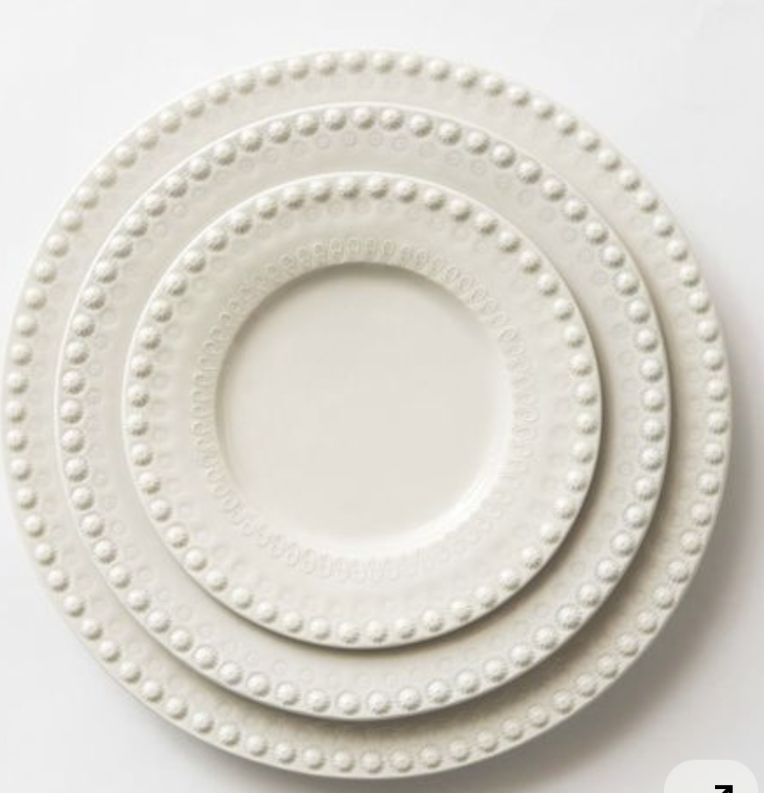
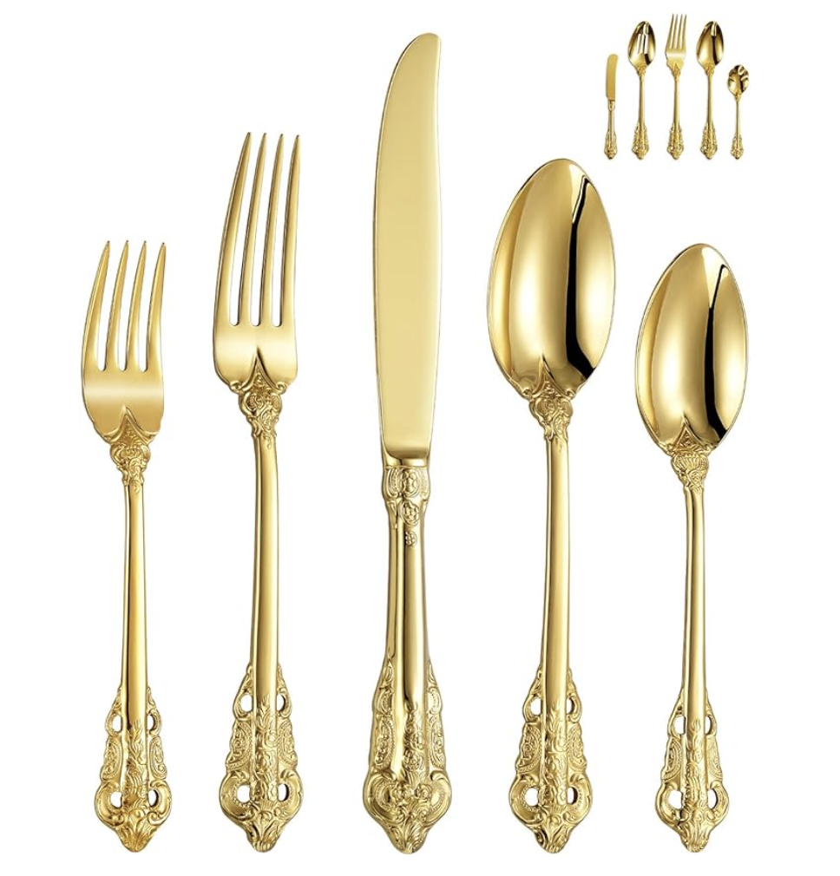
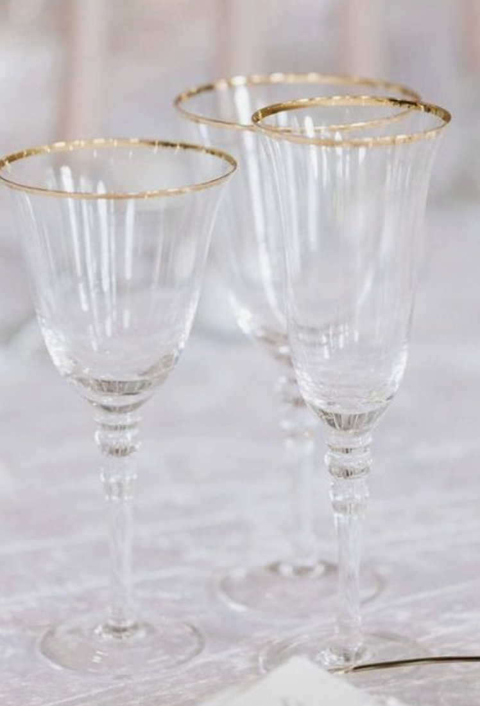
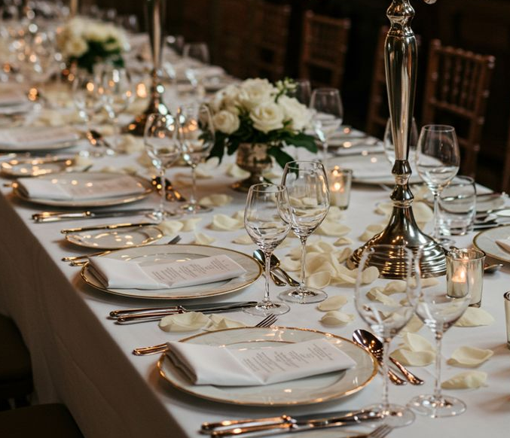
TABLEWARE
Ivory or gold rimmed charger plates will be selected based on rental availability, carefully chosen to match the reference image provided by the bride. Vintage gold flatware will complement the table setting, paired with delicate crystal glassware featuring gold rims and white napkins for a refined and harmonious touch

Slide 17
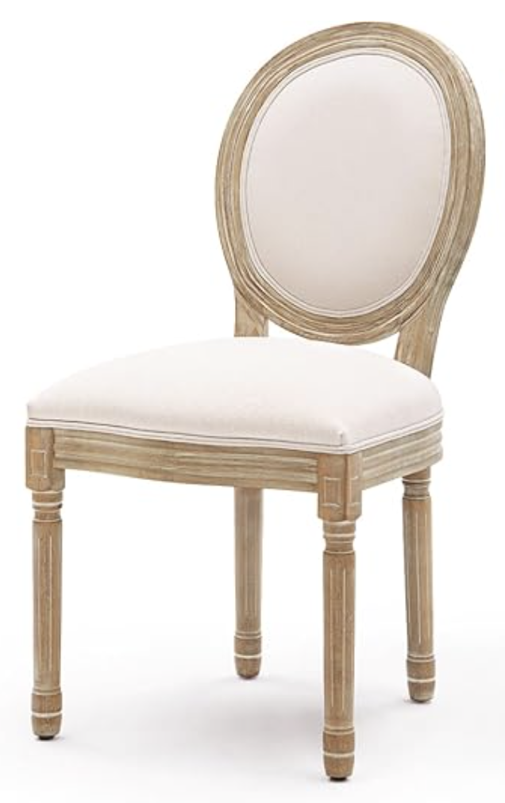
CHAIRS FOR CEREMONY AND
RECEPTION
WOODEN - Louis Chairs

Slide 18
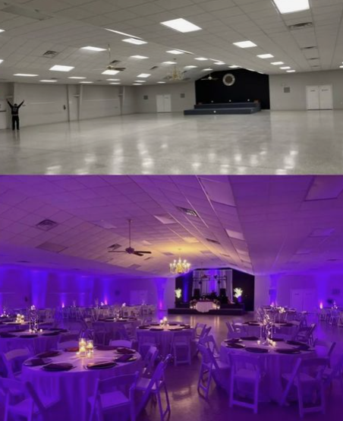
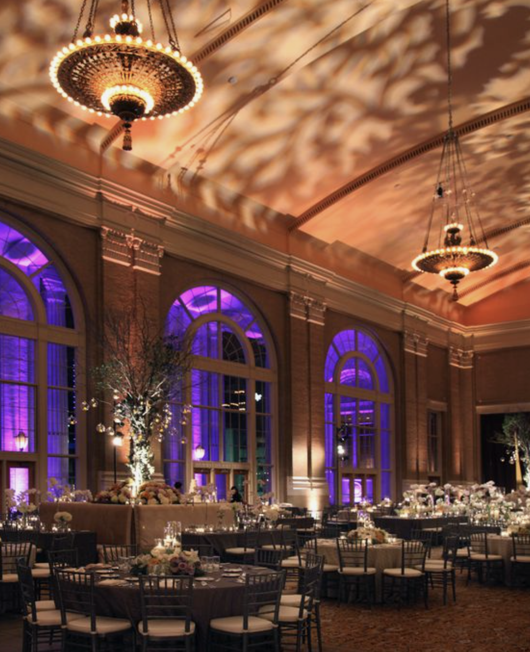
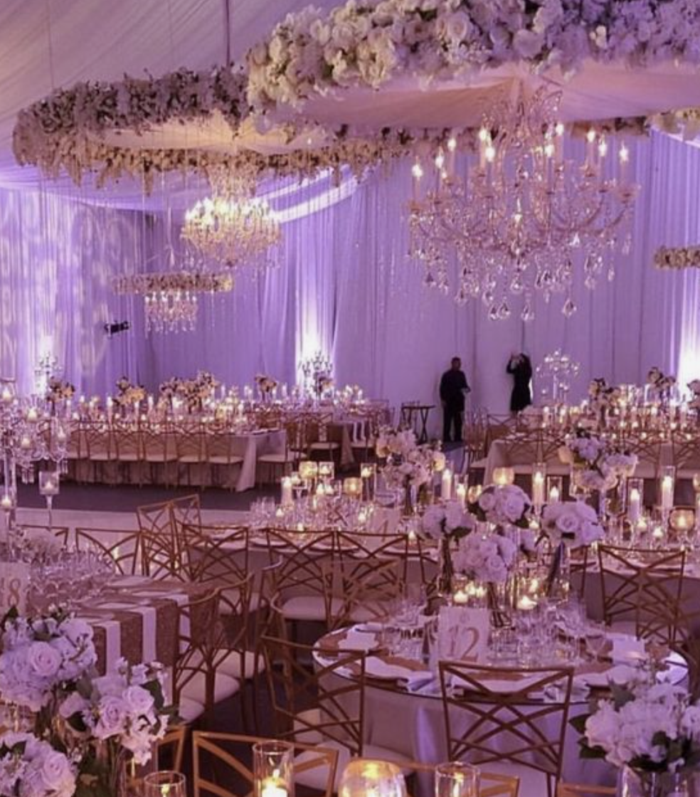
UP LITHING
Audrey’s Note: I highly recommend considering uplighting for your décor. It has a remarkable ability to enhance the overall ambiance by highlighting key elements and adding warmth to the space. Uplighting can truly transform your event, creating a captivating and inviting atmosphere that your guests will love.

Slide 19
FLOOR PLANS

Slide 20
RECEPTION/DINNER SEATING PLAN
The finalized floor plan will be shared upon confirmation of the final guest list

Slide 21
WELCOME DINNER
TBD depending on the venue.

Slide 22
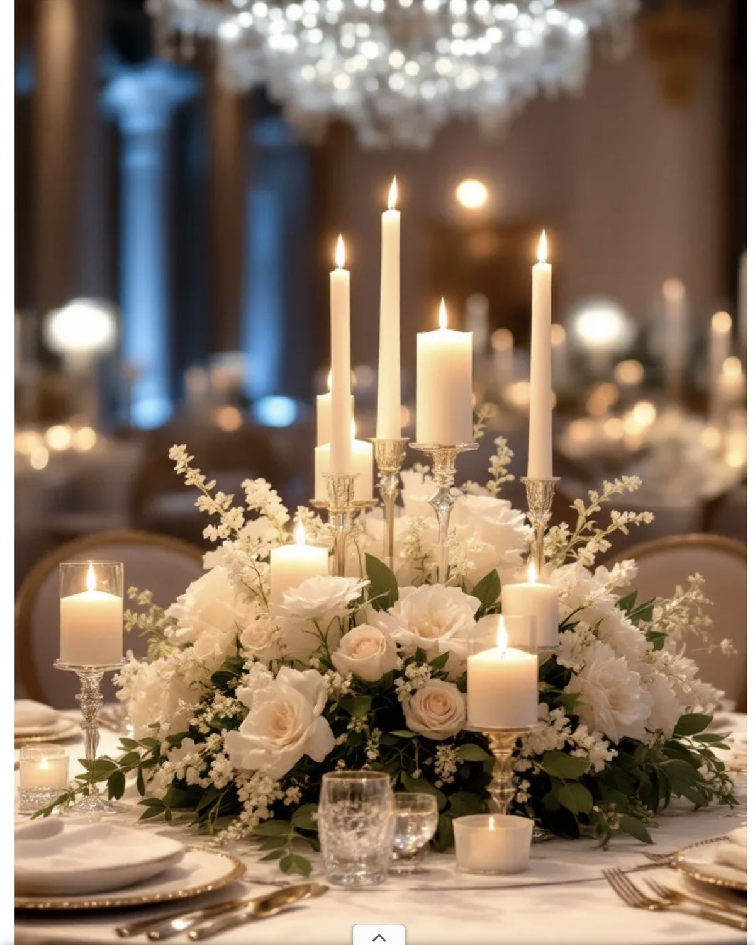
(COCKTAIL STYLE) - Each table will feature a white floral arrangement, complemented by clusters of white taper candles at varying heights, evoking a light, refined, and effortlessly elegant atmosphere

Slide 23
BRUNCH
TBD depending on the venue.

Slide 24
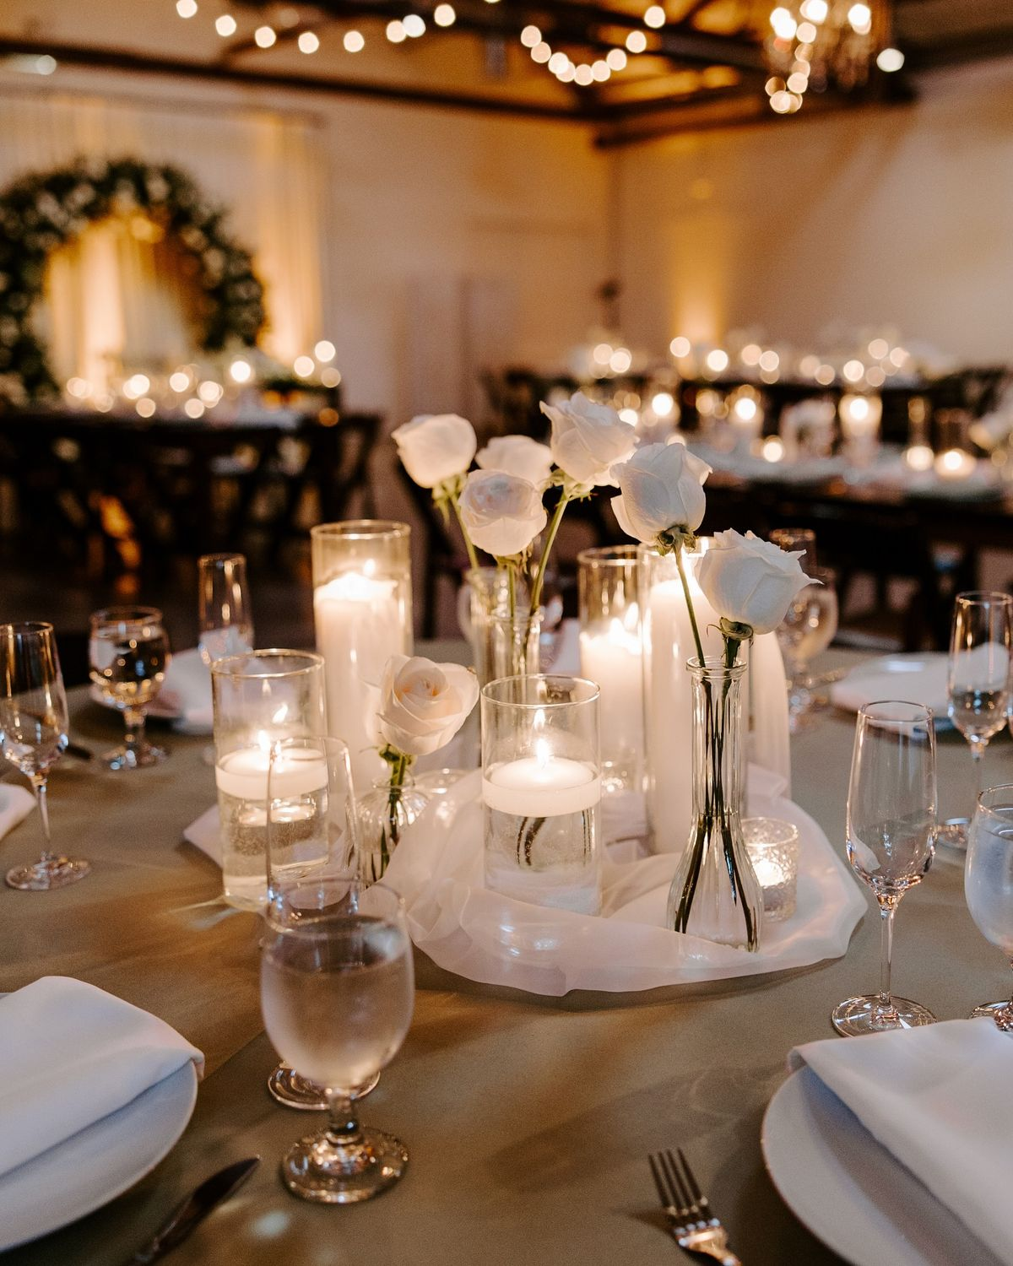
White roses floral arrangements will be placed on each table, displayed in small crystal vases and complemented by votive candles, creating a warm, sophisticated, and effortlessly elegant ambiance

Slide 25
We can’t wait to bring your vision to life!
The concepts (written and images) in this proposal are symbolic of the design inspiration we intend to bring to life for your event. Due to the characteristics of perishable items (flowers), there can be situations that may emerge that are completely out of our control.
To protect the integrity of our creativity, we kindly ask that you do not share the details of this proposal with other vendors bidding for your event. This was made just for you. However, please feel free to share this with your family.

Slide 26
NOTES FOR PLANNER AND FLORIST TEAM ONLY (FRENCH):
Décor de la ceremonie
4 longue tables rectangulaire de 26/28 personnes (soit 13/14 de chaque coté)
8 décor Tables mange debout pour l'heure du cocktail
2 Décor de Bars (1 pour le cocktail - 1 pour la réception/fête)
1 décor pour le welcome sign / panneau de bienvenue
1 décor pour la Table “Welcome” Table (ceci n’est pas mis dans le mood board mais j’aimerai leur presenter une option)
Re disposition des fleurs pour la table du Wedding Cake
REHEARSAL DINNER
8 tables cocktail avec le meme genre de compo que sur la photo
BRUNCH Proposer une option avec 8 table mange debout comme sur la photo
Proposer une option de redisposer les fleurs de l’aveille – cout supplementaire

